Slide 1

Conditional Expressions and Control Statements
Boolean Logic, IF and SWITCH Statements

Slide 2
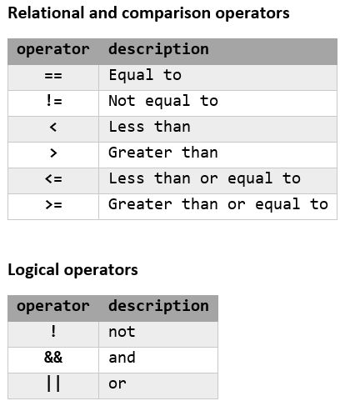
Conditional Expressions
Sequence of identifiers
Separated by compatible operators
Evaluates to true or false
Examples:
a >= b
a == 2*3
b != c % 2

Slide 3
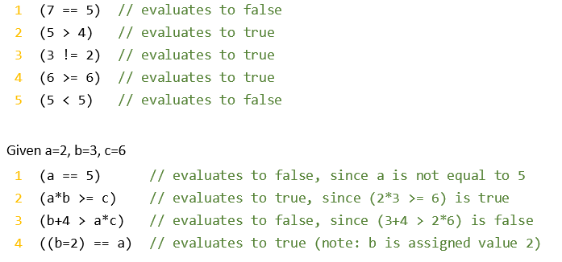
Relational & Comparison Expressions
Relational operators (==, !=) test for equality
Be careful not to use the assignment operator (=)
Comparison operators (<, >, <=, >=) test value ranges
Don’t ever do this!

Slide 4
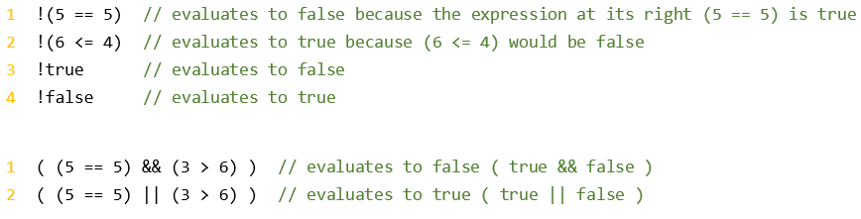
Logical Expressions
Boolean expression is any expression that evaluates to true or false
Logic operators (!, &&, ||) test Boolean values of multiple expressions
NOT (!) returns the opposite of the right Boolean expression
Note: the NOT operator takes only one operand to its right
AND (&&) returns true if both the left and right Boolean expressions are true
OR (||) returns true if either the left or right Boolean expression is true
C++ bool datatype has literal values false=0 and true=1
Any expression that results in 0 is evaluated as false
Any expression that results in a non-0 is evaluated as true

Slide 5
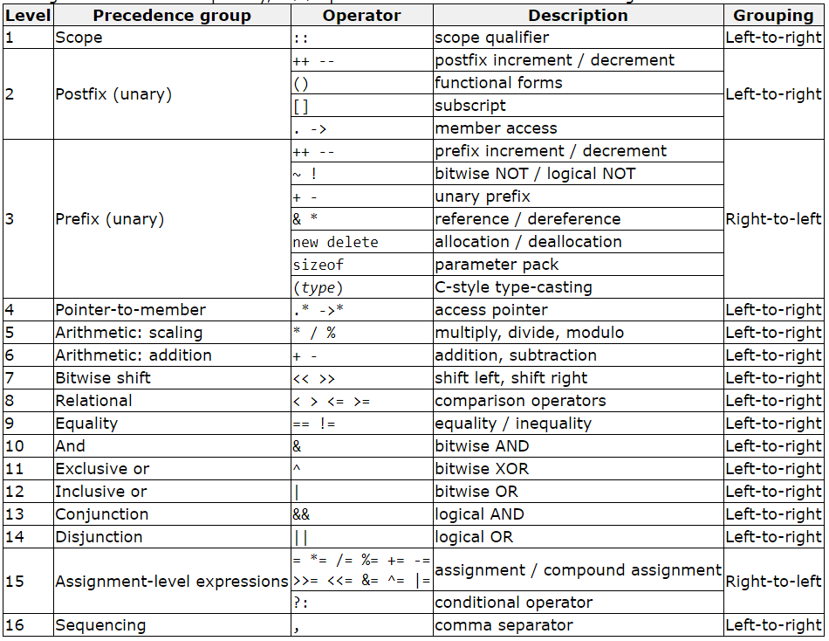
Operators: Order of Precedence

Slide 6

Conditional Ternary Operator
The ternary operator (?) allows us to perform an inline IF-THEN-ELSE expression
Syntax:
condition ? result1 : result2
The expression returns result1 if the condition is true, and result2 if the condition is false

Slide 7
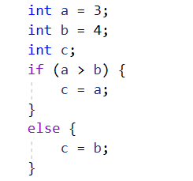
IF Statement
IF keyword executes a statement or block if the condition is true
Syntax:
if ( condition ) statement;
Enclose multiple statements in braces ({ }) to define a block of statements to execute
Syntax:
if ( condition ) {
statement;
…
}
The else keyword defines a statement or block of statements to execute if the condition is false
Syntax:
if ( condition ) {
statement;
…
}
else {
statement;
…
}
Recommended syntax unless single IF with single statement

Slide 8
IF Statement ELSE IF Blocks
The else if keyword defines a statement or block of statements to execute if additional conditions are true
Syntax:
if ( condition ) {
statement;
…
}
else if ( condition ) {
statement;
…
}
else if ( condition ) {
statement;
…
}
else {
statement;
…
}
There can be more than one ELSE IF block
Each ELSE IF requires a conditional expression
There can be only one ELSE block and it cannot have a condition

Slide 9
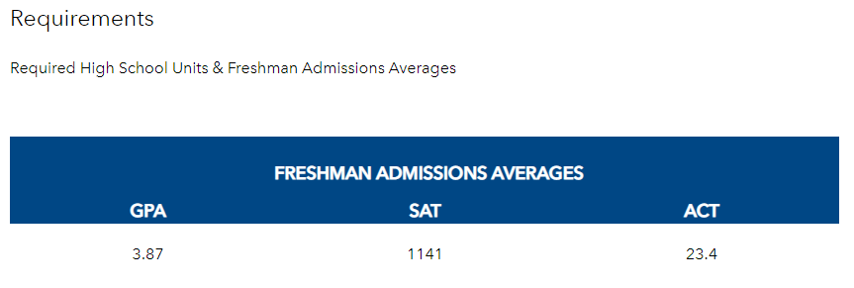
IF Statement Example: Undergraduate Admissions Requirements
Undergraduate Admission Requirements
Must have a GPA of 3.87 or higher
And must have either
SAT score of 1141 or higher
ACT score of 23.4 or higher

Slide 10

IF Statement Example: Undergraduate Admissions Requirements
Single IF statement
Using combination of comparison and logical conditional operators
Pros / cons:
Less code
Difficult to read or change if requirements need to be added
Note: single IF with single statement, so curly braces not required

Slide 11
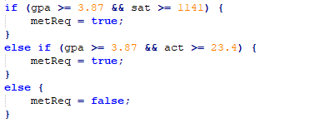
IF Statement Example: Undergraduate Admissions Requirements
IF-ELSE IF-ELSE statement
Break into smaller conditions
Pros / cons:
Easier to read and change
Duplicated evaluation of GPA
ELSE block not required if metReq variable set to false before the IF statement

Slide 12
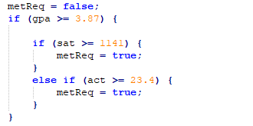
IF Statement Example: Undergraduate Admissions Requirements
Nested IF statements
Break into single comparison conditions
Pros / cons:
Easier to read and change
Note: multiple levels of tabbing to show ownership and scope in each block
Why should you use an ELSE IF for the ACT comparison instead of a separate IF statement?

Slide 13

IF Statement: Bool Variable in Conditional
An IF statement can evaluate a bool variable directly
A bool variable has a Boolean value
Does not require a comparison operator

Slide 14
Set Bool with Boolean Expression
A bool variable type can be set using any Boolean expression
Do not need IF statement structure
Pros / cons:
Confusion between assignment operator and comparison operators
Difficult to read and change
Probably better to wrap whole Boolean expression in parentheses:
bool var = ( a >= b && ( c >= d || e >= f));

Slide 15
SWITCH Statement
Check for value of expression against several possible constant expressions
Syntax:
switch (expression) {
case constant1:
statement;
…
break;
case constant2:
statement;
…
break;
.
.
.
default:
statement;
…
}
Variable or expression that returns a value
Constant value
Exit switch statement
If value of expression does not match any constant value

Slide 16
SWITCH Statement: Rules
Only short, int, long, char, or enum data types can be used
Constant values must be of same data type as expression
Cannot use range values (i.e. < or > )
Should have at least 3 optional values
use IF statement when less than 3
Do not declare variables inside SWITCH or CASE blocks
Some may work, and others will cause compiler errors
Leaving off a BREAK keyword causes CASE blocks to fall-through as if an OR is used:
switch (expression) {
case constant1:
case constant2:
statement;
…
break;
}
The BREAK keyword is not required for the last block, CASE or DEFAULT
DEFAULT block is not required, but is recommended
// expression == constant1 || constant2

Slide 17
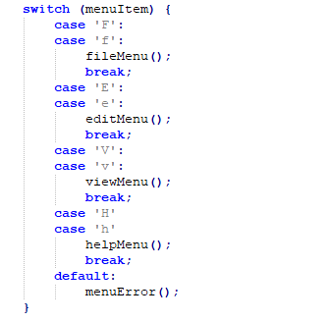
SWITCH Statement: Uses
Control program flow to one of several sub-procedures, such as a menu
Translate or map values to other values, such as numbers to colors, or vice versa
Map individual keystrokes to action values (how might we use this?)
Example:

